Slide 1
Fault-Tolerance in the Borealis Distributed Stream Processing System
Magdalena Balazinska, Hari Balakrishnan,
Samuel Madden, and Michael Stonebraker
MIT computer science & Artificial Intelligence Lab.
Presenter: Youngki Lee
Notes:
Hello, everyone
Today, I am going to present a paper about Fault-Tolerance in the borealis distributed stream processing system.
This work is affiliated with these people at MIT.
This paper is the 4th paper of Borealis project, and published at SIGMOD 2005.
You will know two of other three papers and another is about high-availability.

Slide 2
Contents
One-line comments
Motivation scenario
Technical challenges
Fault-Tolerance Approach
Experimental Results
Critics
New ideas
Notes:
This presentation will follow this order. I’ll summarize this paper with one-line comment and then show you the motivation scenarios.
From the scenario, I’ll derive technical challenges and solution approaches to address those technical challenges.
They implemented their approach in the borealis system, and I will show experimental results of their work.
Finally, I will point out strong and week points of this paper and add some of my new ideas.

Slide 3
One line comment
The paper present a replication-based approach to fault-tolerant distributed stream processing in the face of node failures, network failures, and network partitions.

Slide 4

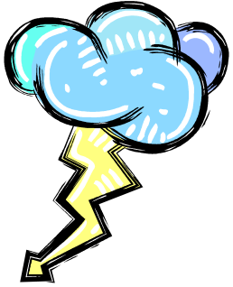




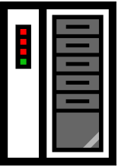



Motivation scenario
SPE
FAILURE
SPE
X: 3 seconds
Downstream
neighbor
SPE
X: 60 seconds
Upstream
neighbor
X: 3 seconds
SPE
X: 1 second
Downstream neighbors want
1. new tuples to be processed within time threshold X
2. to get eventual correct result
Notes:
This picture shows a scenario of distributed stream processing network. Data stream generated in the sensor network is processed as it goes through the chain of SPEs. (upstream neibhor, downstream neighbor 설명) In the scenario, they assume that, downstream neighbors want ~~~. At this point, let me assume that a node in the processing chain fails. Failure happens when a node can’t get one of its input streams within a appropriate time so that it can’t process new tuples within the user-specified time threshold. Once a node fails, it starts to generate tentative results. To solve this problem, they put one or more replicas for each node. If there are replicas, a downstream neighbor can connect to the one of the replicas when a failure of upstream neighbor is detected. With this approach they can solve the failure of a node. However, due to many reasons such as previous upstream failures, long network delay or concurrent system failures, there could be no upstream neighbors, which produces correct results. In that case, one of the upstream nodes must produce tentative result using partially available inputs to meet the user-defined availability. This tentative result might propagate to the next downstream node. (this makes sense in the stream processing domain) (So~, user defined threshold is long, ~~~ whereas if it is short ~~~) Once a failure heals, the node start to correct the previously generated results. There are two reasons to do this. One is to deliver the correct result to the users, which is the target requirement of the Borealis system and another is to keep the consistency between replicas.

Slide 5
Technical challenges
Provide user-defined availability
Keep consistency among replicas
Provide eventual correct result
Notes:
So I derived three major three technical challenges from the scenario. One is providing user defined availability even though all of the input streams are not fully available. In the meanwhile, all replicas could maintain consistency so that a downstream node can connect to any of the upstream replicas at any time. In addition, every SPE node should provide eventually correct result.

Slide 6
Fault-Tolerance Approach
If an input stream fails, find another replica
No replica available, produce tentative tuples
Correct tentative results after failures
STABLE
UPSTREAM
FAILURE
Missing or tentative inputs
Failure heals
Reconcile state
Corrected output
Another upstream failure in progress
STABILIZING
Notes:
To address those challenges, they design a node to have three possible states and transit from one to another, I will show and explain the state diagram.
Before I present the diagram, the approach could be summarized as follows. A nodes are in a STABLE state when it gets all the necessary input streams which are not tentative, and produces correct results within user-specified time threshold. During stable state, if a node can’t get one of input streams or if a node get tentative input streams it change its state to UPSTREAM FAILIRE. In this state the node itself generate tentative result. Generating tentative result could result in two problems. , (1) Continuing leads to inaccurate results, (2) Continuing leads to replica divergence. So, once a failure heals the node changes its state to Stabilizing and reconcile its internal states and generate corrected output. When stabilizing is over it goes to STABLE state again. However, if another upstream failure occurs during stabilizing process it goes back to UPSTREAM FAILURE state.

Slide 7
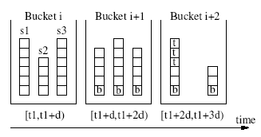
Fault-Tolerance Approach : STABLE
Only need to keep consistency among replicas
  Deterministic operators
  SUNION
TCP connection
Node 1
SUNION
Σ
s₁
s₂
s₃
Node 1’
SUNION
Σ
Notes:
I’ll explain what will happen in each state more specifically. First in the stable all the inputs are available and nothing for a SPE to care about. But, because there are several replicas for a node they could ensure the consistency between the nodes. Before I talk about the consistency between nodes you need to know the meaning of deterministic operators. An operator is deterministic if its results do not depend on the times at which its inputs arrive. They solve the consistency problem only when there are deterministic operators. . If all operators are deterministic we only need to ensure that replicas of the same operator process data in the same order to maintain consistency. When a SPE node process single stream, the problem becomes very easy. A single stream can be serialized by just using TCP connections. However, when a SPE get many streams as its input, it is not typical problem. To serialize inputs from many stream sources they introduce SUNION operator. Basically the SUNION operator collects all the input streams, in this example three, and deterministically sorts the tuples by time. To help this, each stream sends boundary tuples with boundary time, SUNION operator put the tuples between two boundary tuples together and sort them. With this method SUNION can serialize input streams from more than one sources.

Slide 8
Fault-Tolerance Approach : UPSTREAM FAILIRE
If an upstream neighbor is no longer in the STABLE state or is unreachable
  Switch to another STABLE replica
  If no STABLE replica exists, it continues with data from a replica in the UP_FAILURE state
    Delay new tuples as much as possible(X-P) and process
    Or just process without any delay

Slide 9
Fault-Tolerance Approach : STABILIZATION
State reconciliation
  Checkpoint/redo
  Undo/redo
Stabilizing output streams
Processing new tuples during reconciliation
  If (Reconciliation time < X-P) then suspend
  else delay, or process
Failed node recovery
Notes:
Once a node get into the stabilization state, there are several things to do. First it must correct the states of operators for consistency and also stabilize output streams to send the eventual correct result to users. There are two methods for state reconciliation. One is checkpoint/redo and another is undo/redo. (각각에 대한 설명) (1)checkpoint during stable state(save the states of all operators) -> buffer input streams after last check point

Slide 10
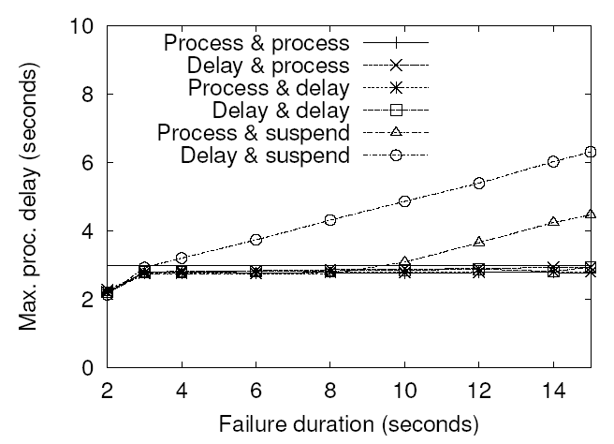
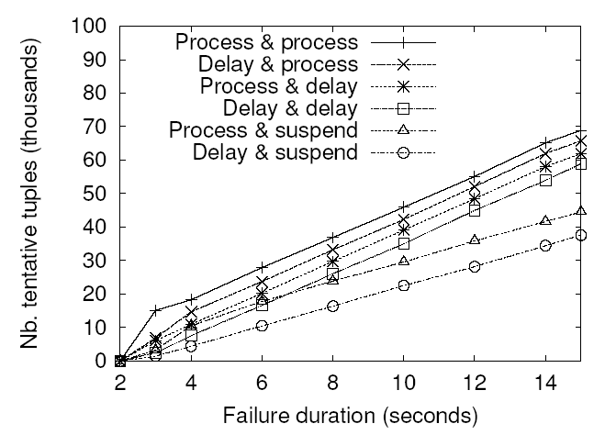
Experimental results(1/2)
Notes:
6 Combinations, X축 Y축 설명.

Slide 11
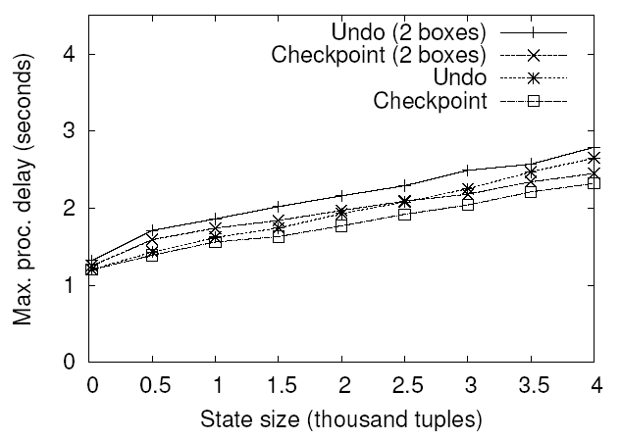
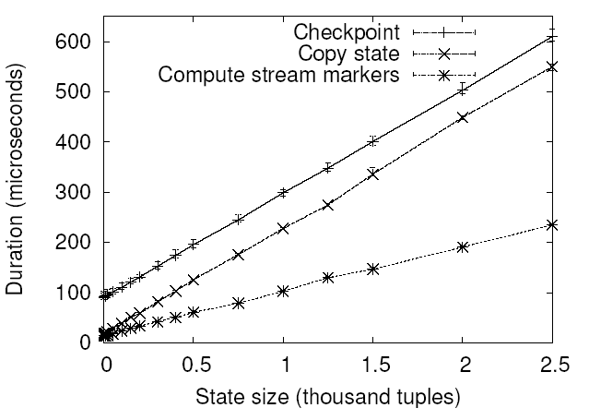
Experimental results(1/2)
Reconciliation (performance & overhead)
Notes:
Reconciliation ->performance in terms of delay, and overhead

Slide 12
Critiques
Strong points
  Their method reduce the degree of inconsistency while guaranteeing high availability using the characteristics of data streams
  Actually implement their scheme in Borealis system
Weak points
  Only support deterministic operator
    Solving consistency problems only serializing input streams
    Time window -> not exact consistency
  Too much overhead
    Processing overhead by replications
    Memory overhead
      Buffering tentative input streams
      Buffering output streams which might used by other downstream neighbors
  Is result modification actually necessary?

Slide 13
New ideas
Put replicas in regionally distributed area and construct content distribution stream network.
  Downstream users are distributed
    Scalability and fast response time
    Also provides fault-tolerance and high availability
  overlay multicasting of source streams, service discovery might be necessary
What if different users pose all the different queries
  Fine-granularity stabilization is necessary.
  User must be able to specify the eventual correct result is necessary or not
Communication between replicas could reduce the computations and might support non-deterministic operators
  K out of N replicas process
Notes:
Reconciliation 때도 왜 새로 다처리하냐? 될 수 있으면 replica에서 state와 필요한 tuple copy해 올수도 있는데?

Slide 14
Questions?

Slide 15
Operator-level scenario
Node 3
U
μ
s₃
Node 1
Node 2
U
Σ
μ
s₁
s₄
Node 1’
Node 2’
s₂
U
Σ
μ
Node 3’
U
μ
s₃’
Notes:
This is the operator level diagram. For instance, in this three node system, they provide fault-tolerance by running one or more replicas of each processing node. Each node monitors all upstream replicas and can get its inputs from any one of them. Hence, if a node fails, its downstream neighbors reconnect to another replica. For instance, if node 1 fails, node 2 and 3 re-connect to node 1’. The challenge is when partitions occur. For instance, if node 1’ is not available because it is disconnected. In that case, a node can either block... and node 2 has no choice but to block because its join operator cannot continue with a missing input stream or it can continue with the remaining inputs. In stream processing application, it often makes sense to continue. For instance, if node 3 is running a network monitoring query and its two inputs come from two subnetworks, then if one subnetwork becomes unavailable, it is nevertheless useful to continue and monitor the remaining subnetwork. We therefore chose this approach. However, (1) Continuing leads to inaccurate results, (2) Continuing leads to replica divergence. Hence we are going to label output tuples as tentative so downstream nodes can reconnect to a stable replica if one exists. When the failure heals, we will reconcile the node’s state and correct the output it produced during the failure.

